Slide 1
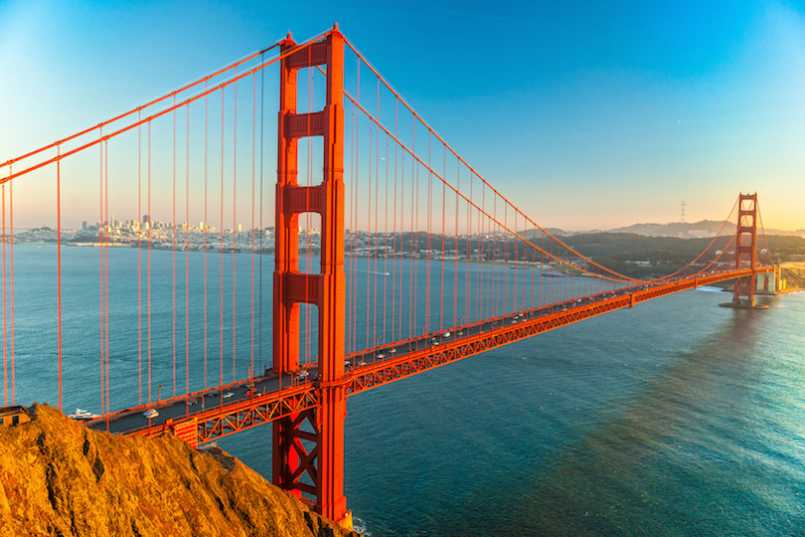
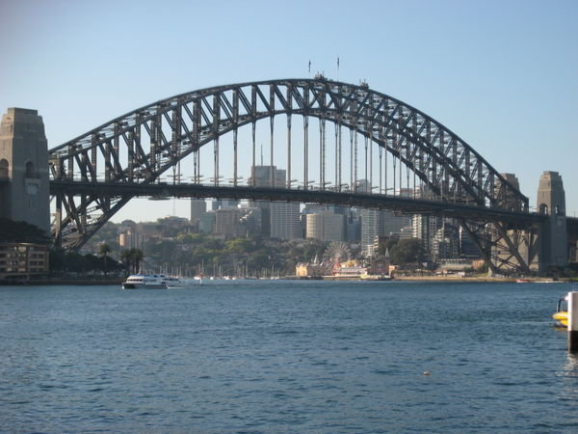
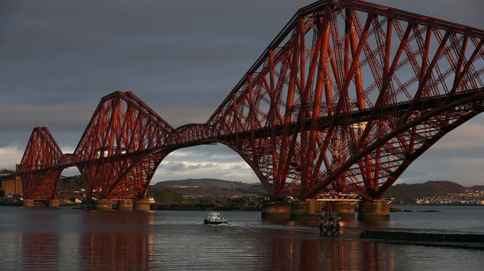
Bridge Building!

Slide 2
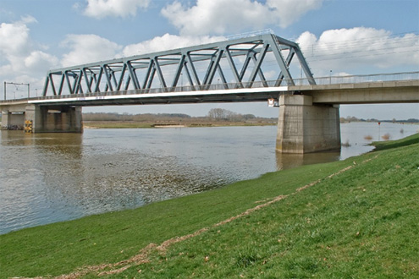
What Makes A Strong Bridge?
The triangle shape has been found to be the strongest in bridge building, largely because its angles do not change significantly, thus buckle, under stress as other shapes do

Slide 3
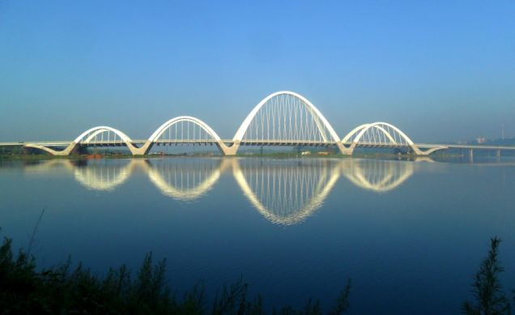
Can you list Any Famous Bridges You Know?

Slide 4
Tacoma Bridge Collapse
Notes:
The bridge was built in such a way that the wind would be able to pass above and below the structure rather than through the truss. Once construction was finished, they found that it would sway and buckle under even mild wind conditions. The bridge collapsed because winds of 40 miles per hour caused the left side of the bridge to rise and the right side to fall, and vice versa, while the center lined remained stationary. Eventually the bridge’s movements proved to be too much which caused it to collapse.
Tacoma, Washington. 1940

Slide 5
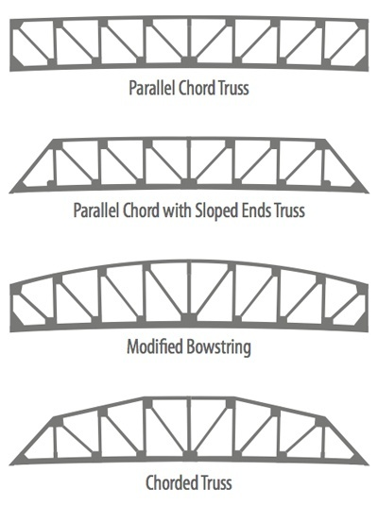
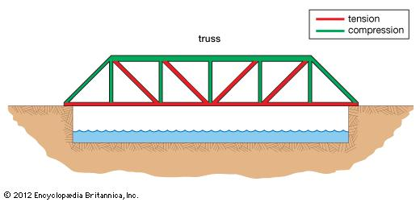
Bridge Ideas To Consider

Slide 6
Materials:
Spaghetti
Marshmallows
Paper Cup/Bowl
Paperclips

Slide 7
Making Bridges:
Start by building the sides of the bridge with spaghetti and marshmallows in the shape of an isosceles rectangle. Make sure the top and bottom pieces are straight.
Next add small pipe cleaner pieces inside the framework to form triangles inside.
Decide the best way to construct the top and the bottom of the bridge and attach the sides.
Test the bridge strength by placing a cup of paperclips on top of it. Count how many paperclips before it falls!
Keep in mind right angles and triangle shaped framework make stronger bridges
Keep in mind that you may split the spaghetti in half as well

Slide 8
Wrap Up
What geometric shapes make the strongest bridges
What else makes a bridge strong
Notes:
Triangles, right angles

