Slide 1
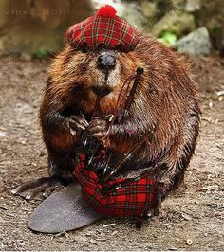
Beavers: Natural Civil Engineers

Slide 2
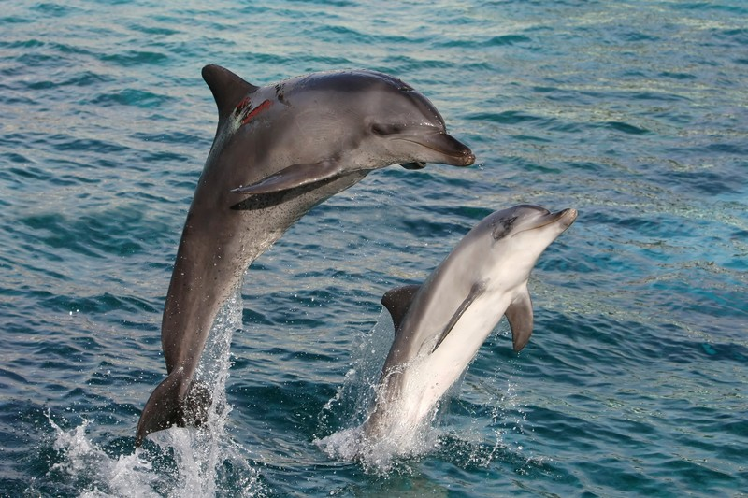
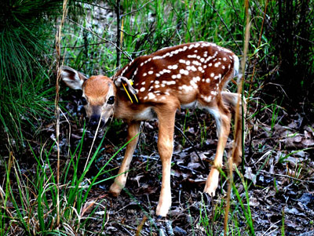
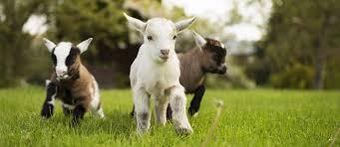
How do animals adapt to their environment?
Notes:
How Animals Adapt to their environment?
Polar Bears in Arctic have thick fur to adapt to keep warm on land and a layer of fat under skin to help keep warm when they swim in cold water.
Beavers have large, ever-growing sharp teeth so they can cut down trees. This helps them have access to food that they can't reach unless the tree falls.
Beavers have underwater vision so they can see in the water while swimming

Slide 3
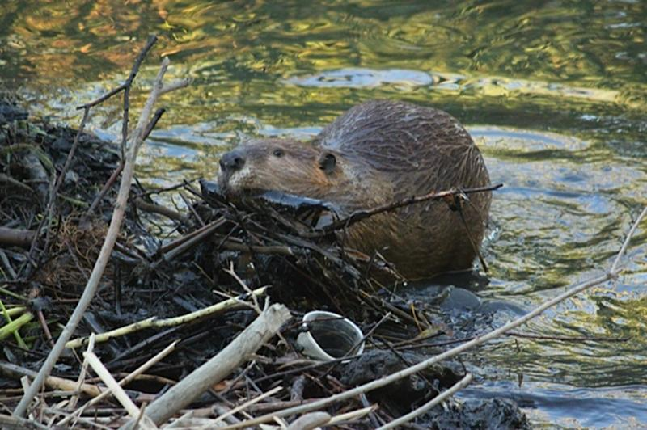
Beaver Questions:
Why do Beavers Build dams?
What are the differences between a Beaver dam and Beaver lodge?
What does "As busy as a beaver” mean?
Notes:
Beaver colonies create dams of wood and mud in order to protect against predators such as wolves, coyotes, and bears. Also, they can float food and building material to their homes.
Once the dams are completed and ponds formed, beavers will work on building their homes called lodges in the middle. The dome shaped lodges, like the dams, are constructed with branches and mud. Lodges have underwater entrances, making entry tough for most other animals.
Beavers like to keep themselves busy by building during the night. Hence the saying "As busy as a beaver.”

Slide 4
Fun Video on Beavers Building their homes

Slide 5
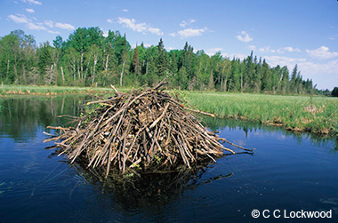
What Material do you think is the strongest to build a dam?

Slide 6
Project Directions
Take a rectangular tray and make a dam with soil, gravel, sticks.
Be Creative with the Materials you use!
Fill the area of one side of the dam with water. Elevate one side of your dam.
Observe the dam to see if it is able to withstand the water. Measure how long it is able to.
Try determining which materials were best at making a strong dam!
Afterwards, please help clean up the floor and any mess left! :)

Slide 7
Clean Up Procedure
I will assign each student a number. Please remember that number!
Number 1: Dump out the contents in your trays in the waste buckets provided
Number 2: Take the trays from number 1 and wash the trays thoroughly
Number 3: Dry the trays thoroughly
Number 4: Clean your workplace! Make sure to dust off your surrounding area and put materials where they need to go.
For instance, please put your water can back where the supplies are found
Put the stopwatches back where the supplies are found
I will give out more information

